Slide 1
Application of Artificial Super Intelligence in Investing and the Importance of Compounding and Income Tax Reduction ©2018 by Jeff Glickman and Jonathan Blattmachr. All Rights Reserved.

Slide 2
What Do the Following Have in Common?
GRATs
Planning for Retirement
QPRTs
Planning to Fund the Education of Descendants
Installment Sales to Grantor Trusts
Charitable Lead Trusts
Gifts to Long Term Trust (Using the Enhanced Exemption)
Low Interest Loans
Building Great Wealth
Or What Makes Them All Successful (Or Not)?
Investment Success (or Failure)

Slide 3
What Would You Recommend?
Client Wants to Reduce Her Taxable Estate by Making Life Time Gifts
Should She Give Bonds or Growth Stocks?
Should She Give It Directly to Her Descendants, to a Long Term Trust Which Is a Grantor Trust or to One That Is Not a Grantor Trust?

Slide 4
Importance of Avoiding Income Tax
Seeking to Reduce or Avoid Income Tax Is Sensible Only If There Is Positive Taxable Income or Gain
Returns Need to be More than De Minimis
Higher the Return the More Important the Reduction of Avoidance of Income Tax Becomes
Risks and Consistency Once High Returns Are Achieved

Slide 6
Importance of Compounding
Importance of Compounding
Albert Einstein’s First Theorem: Compounding is the most powerful force in the universe
My family has 2 descendants per generation (2 children, 4 grandchildren, 8 great grandchildren and so on)
Your family has 3 descendants per generation (3 children, 9 grandchildren, 27 great grandchildren and so on)
In 20 generations, I have one million descendants living
In 20 generations, you have 3.5 billion descendants living and your attributes overwhelm and wipe out mine

Slide 7
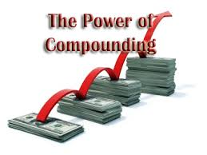
Compounding & Returns
Importance of Compounding and Level of Returns
Which Return Would You Prefer: 5% Compounded or 10% Simple (Non-Compounded)?
Simple vs Compounding return – Exhibit 1

Slide 8
Simple vs. Compounded Return
10% Compounded Growth
5% Compounded Growth
10% Simple Growth
5% Simple Growth

Slide 9
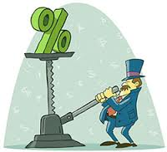
Corollaries in Compounding
Again, the Importance of Compounding: Some Corollaries
The Longer the term, the greater the effect of compounding
The Higher the annual return, the greater the relative increase in wealth from Compounding

Slide 10
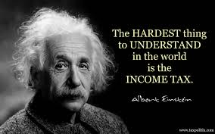
Albert Einstein’s Other Theorem: The hardest thing in the world to understand is the income tax
The Effects of Taxation on Compounded Returns After 20 years – Exhibit 2

Slide 11
Returns and Taxation – What the Numbers Tell Us
61% reduction due to taxes
49% reduction due to taxes
31% reduction due to taxes
17% reduction due to taxes

Slide 12
Returns and Taxation – What the Numbers Tell Us
86% reduction due to taxes
75% reduction due to taxes
52% reduction due to taxes
32% reduction due to taxes

Slide 13
Observations about Taxation
The higher the effective rate of annual taxation, the greater the erosion of wealth
The higher the return, the more the return is eroded by current income tax
Blattmachr’s Corollary: The Most Important Thing in Financial Planning Is Tax Free Compounded Returns

Slide 14
Basic Principles of Tax Reduction
How to Reduce or Avoid Tax Erosion
Some Basic Principles:
Deferral of taxation is beneficial but only if returns are compounded and all other things are equal
Example: An employee is entitled to $1 million of compensation for 2015. The employee is in a 40% income tax bracket. If the employee is currently taxed in 2015 on that income, he or she will net $600,000, which could be spent or saved in 2015. Assume the employee could and does postpone the receipt of the income until 2016 when it still will be taxed at 40% so he or she would again net $600,000, which could be spent or saved in 2016. Assuming no earnings on the net (after tax) income, it seems unimportant whether the income is received in 2015 or 2016 although, in the real world, one almost certainly will want income (or any other wealth) as early as possible (again, if all other things are equal). That is either because the receipt of the income in 2015 will reduce expending other resources in 2015 or because it will be invested.

Slide 15
Deferring Taxation
More on Deferral
Example Continued: The employee is entitled to $1 million of compensation. The employee is in a 40% income tax bracket. If the employee is currently taxed on that income, he or she will net $600,000. If that $600,000 is invested and earned six percent (6%) over the next year, it will earn $36,000 which it is assumed also may be subject to a 40% income tax, meaning that the employee will have $624,000 net after the year. If the taxation of the $1 million of compensation income were deferred for a year and during that year earned six percent, the taxpayer would be entitled to $1,060,000 after one year. If that then also were subject to a 40% income tax, the employee would net $636,000 or $12,000 more than if the taxation had not been deferred.
Essentially, the enhanced wealth is attributable to earning a return on the deferred tax

Slide 16
Conclusions on Deferral of Taxation
Deferral of Taxation Is Important If There Are Earnings on the Deferred Amount (Which May Be Attributed to Earnings on the Tax that Is Deferred), If All Other Things Are Equal

Slide 17
Tax Reduction by Category of Investment
From Worst to Best: (1) Taxable Interest, short-term capital gain and other “ordinary” income (40% tax rate), (2) Long-term capital gain and qualified dividends (20% tax rate), (3) Tax free (Plus Complications, such as SALT, Deductions, Section 199A, and so on).
But the market tends to “even” out returns based, in part, on taxation of the return
Which is better: 10% annual taxable return or 6% annual tax free return?
At a 50% tax bracket, the net (after tax) return on the 10% taxable return is 5% which is less than the 6% tax free return
At a 40% tax bracket, the net (after tax) return on the 10% taxable return is 6%, the same as the 6% tax free return
At a 30% tax bracket, the net (after tax) return on the 10% taxable return is 7% which is more than the 6% tax free return
(

Slide 18
By and Hold Investment Strategies
Buy and Hold
Advantages of a permanent buy and hold investment strategy
Complete tax postponement
Irrelevant if no growth (and only current return, such as interest or dividends)
Income tax free “step up” in basis at death (if no IRD)
Disadvantages of a buy and hold investment strategy
Missing out on other (better) investment opportunities
Tax cost of cashing out to change investments (but that may be the case whenever the investor wishes to change investments) except when the investment’s value has not appreciated (e.g., municipal bond or Section 1031 real estate)
Note: The Tax Law Will Change

Slide 19
“Qualified” Retirement Vehicles
IRAs and qualified retirement plans
Advantages
Tax deferrals (no tax cost to change investments)
Income tax deductible contributions (so compounding and deferral on the income tax not current paid)
Avoiding tax to change investments
Asset protection (except some IRAs in some states)
Avoiding state/local income tax if change in residency (in some cases)
Disadvantages
All taxed at ordinary income tax rates
No estate tax planning available
Penalty if under age 59 ½
Complications for disposition at death
Complications on reaching at 70 ½ +
Limitations on investments
Conversion to a Roth IRA: At least a dozen factors to consider

Slide 20
Tax Deferred Annuities
Advantages
Tax deferral
Limitations on investment choice (unless PPVA)
Avoiding tax in changing investments
Asset protection (in some states)
Avoiding state/local income tax if change in residency (in some cases)
Disadvantages
All taxed at ordinary income tax rates
Penalty if under age 59 ½
No step up in basis at death (IRD)
Potential Investor Control issues

Slide 21
Charitable Remainder Trusts
Advantages
Tax deferral/avoidance on gain inherent in contributed assets
Tax deferral
Avoiding tax when changing investments
Partial charitable deduction
Flavor of income does not change
Disadvantages
Loss of trust assets to charity
when trust ends
UBTI tax (100%+)
Comparison to tax deferred annuities

Slide 22
When Might Life Insurance Make Sense?
Advantages
Easy estate tax avoidance
Easy asset protection (in most states)
Complete income tax avoidance and tax free receipt on death
Can borrow the income tax free before death if not a MEC
Disadvantages
Term insurance, premium tax and annual insurance company costs; tax cost of termination
Limitations on investment choice unless PPLI but then owner control issues
Blattmachr’s Formula: Anticipated return must exceed the quotient of annual cost (in basis points) divided by anticipated income tax rate (in basis points) on the realized annual gain/income the investment produces

Slide 23
Example When Life Insurance May Make Sense
Example 1: Anticipated annual cost (100 basis points or one percent) divided by anticipated annual tax rate on the return (25 percent) is 4. Hence, consider the PPLI policy only if the anticipated annual return exceeds 4 percent
Example 2: Anticipated annual cost (80 basis points or .8 percent) divided by anticipated annual tax rate on the return (40 percent) is 2. Hence, consider the PPLI policy only if the anticipated annual return exceeds 4 percent
Example 3: Anticipated annual cost (120 basis points or 1.2 percent) divided by anticipated annual tax rate on the return (15 percent) is 4. Hence, consider the PPLI policy only if the anticipated annual return exceeds 8 percent

Slide 24
Conclusions
Conclusions
High Compounded Returns and Low Taxation Are the Keys to Building Wealth
The Greater the Return the More Important Is Compounding
The Greater the Return the Greater Erosion from Taxation
Which Method Is Best to Avoid/Reduce Tax is Dependent Upon Several Variables

Slide 25
Introduction to Greater Returns
Investing the markets has been limited to value investing, technical analysis, quantitative analysis and high frequency trading, sometimes involving Algorithms (“algos”) and Machine Learning (“ML”).
The common thread: These methods locate and exploit mispriced assets.
But returns in excess of these methods are possible if you understand the markets. This is beyond human cognition, but within the grasp of emerging computational methods:
Artificial Superintelligence: “…intelligence far surpassing that of the brightest and most gifted human minds” [https://en.wikipedia.org/wiki/Superintelligence]

Slide 26
Perhaps, the Greatest Change in Human History: Artificial Super Intelligence
William Bryk, “Artificial Superintelligence: The Coming Revolution,” Harvard Science Review (December 4, 2015):
The science fiction writer Arthur Clarke famously wrote, “Any sufficiently advanced technology is indistinguishable from magic.”
Yet, humanity may be on the verge of something much greater, a technology so revolutionary that it would be indistinguishable not merely from magic, but from an omnipresent force, a deity here on Earth. It’s known as artificial super-intelligence (“ASI”), and, although it may be hard to imagine, many experts believe it could become a reality within our lifetimes.

Slide 27
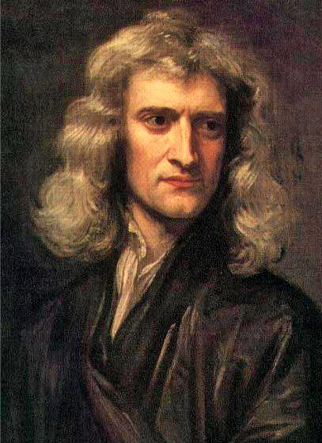
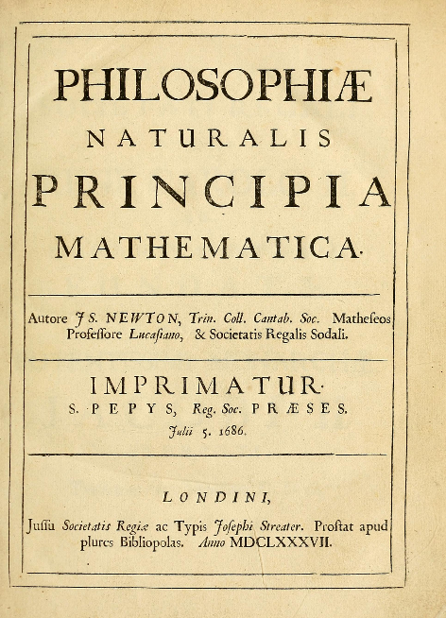
A Precursor
Sir Isaac Newton was the first to explain the motion of the heavens through mathematics in his book Philosophiæ Naturalis Principia Mathematica ("Mathematical Principles of Natural Philosophy") published in 1687. [https://en.wikipedia.org/wiki/Isaac_Newton] [https://en.wikipedia.org/wiki/Philosophi%C3%A6_Naturalis_Principia_Mathematica]

Slide 28
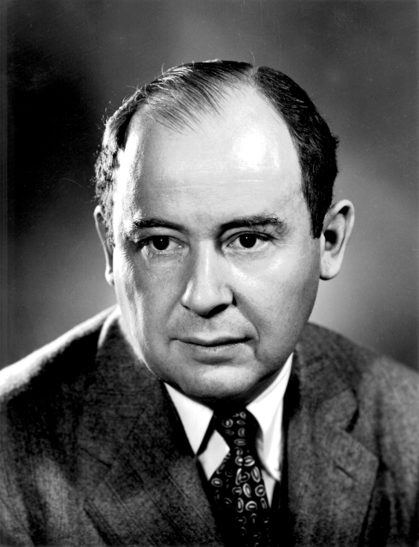
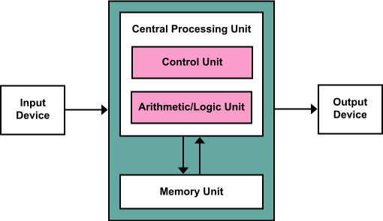
The von Neumann Architecture
In 1945 John von Neumann, a Hungarian-American mathematician at Princeton University, defined the modern computer in his paper “First Draft of a Report on the EDVAC.”
Known as the “von Neumann Architecture”, nearly all succeeding computers since 1945 have descended or evolved from this blueprint. [https://en.wikipedia.org/wiki/John_von_Neumann] [https://en.wikipedia.org/wiki/Von_Neumann_architecture]

Slide 29
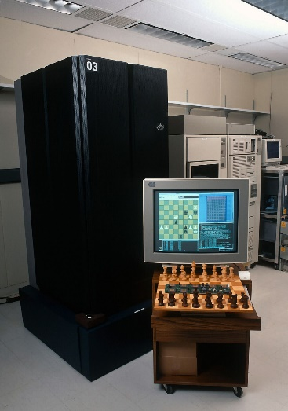
Performance Architectures
Beginning in 1948 the first electronic computers began operating at 1,000 instructions (e.g., additions) per second.
Since 1948 there has been an arms race to build ever faster computers. Each succeeding generation incorporates architectural enhancements (e.g., pipelines, split caches, parallel computing), which increases transistor counts, allowing us to tackle ever increasingly complex problems.
The initial calculations in 1948 were ballistic trajectories. Since then, bookkeeping and accounting, simulations, chess, weather prediction, machine learning, artificial intelligence, self-driving vehicles, go.
IBM Deep Blue first beat a world chess champion, Garry Kasparov, February 10, 1996. Image Yvonne Hemsey/Getty Images

Slide 30
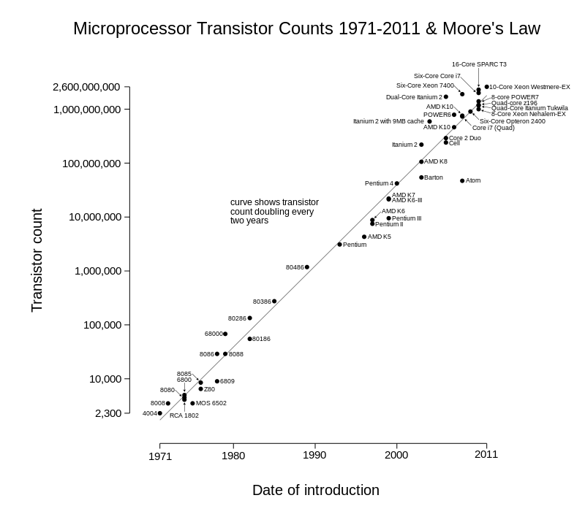
Supercomputing
In 1965, Gordon Moore, the cofounder of Fairchild and Intel, defined Moore’s law, which states that the number of transistors per square inch doubles approximately every two years. [https://en.wikipedia.org/wiki/Moore%27s_law]
Therefore computers are becoming exponentially more powerful.
Supercomputers are computers that are more powerful than their general purpose counterparts of their generation.

Slide 31
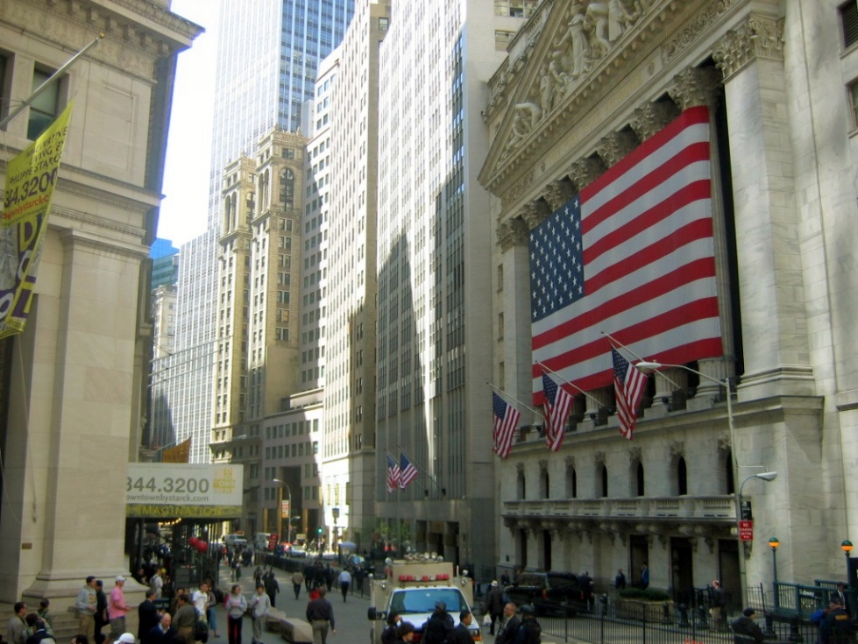
Computers on Wall Street
Computers had a humble beginning on Wall Street, however they have now infiltrated virtually every market function.
Beginning with mundane tabulation and sorting, computers moved on to provide accounting support, data automation, eventually moving into the investment process
including Calculating, Market Scanning, Data Analytics, Automated Trading and Electronic Exchanges.

Slide 32
Automating the Search for Price Discrepancies
Value Investing: e.g., automated review (filtering; market scanner) of fundamental data to identify underpriced stocks.
Statistics: e.g., the expectation that trade distribution are gaussian (normal distribution); or the use of probabilities to predict price increase (e.g., Bayesian Models).
Technical Analysis: e.g., the examination and interpretation of chart patterns.
Physics: e.g., the application of physics models such as money being particles that flow through connected pipes.
Quants: e.g., search for correlations between stocks such as oil and United Airlines; relationship between Dow and S&P 500 Indices; weather influence on commodity prices.
Algorithmic Trading: automatic trading by programs based on criteria such as measured in market data (black box with frequency beyond human capability)
High Frequency Trading: e.g., trading very frequently but with only a small advantage; quickly getting in front of another order.

Slide 33
Artificial Intelligence
Artificial Intelligence(AI): any computational method that attempts to recreate intelligence using computers.
Artificial Neural Networks: a type of AI based on mathematical models of neurons found in humans, animals, etc.
Machine Learning: a type of AI; programs that learn from data without being programmed.
Deep Learning: a type of AI; broader machine learning with improved abilities to learn from data.
AI typically approaches human capabilities.
AI programming is static, causing AI to be restricted within these limits.
AI in the markets has had limited success. The market is seen by people as a random walk and it is seen the same way by AI.

Slide 34
Artificial Superintelligence (ASI)
Artificial Superintelligence is the consequence of the convergence of:
Massive amounts of computing power, and
The discovery of non von-Neuman code
Combined, the programming in an Artificial Superintelligence becomes dynamic rather than static, enabling the emergence of cognition far exceeding human capabilities, capable of more complex, deeper thought.
Artificial Superintelligence does not see the market as a random walk. With its abilities surpassing that of a human, it understands complex structures that underlie the market, which are far beyond human ability to comprehend.

Slide 35
Financial Engineering of Investment Attributes by an Artificial Superintelligence: A Brave New World
In 1893 Hawley’s put forth his risk theory of profit. Today we have know it as high risk = high profit, low risk = low profit. Today this is market dogma, however Artificial Superintelligence is redefining everything we thought was true about investing. For example, ASI decouples this relationship, deriving high returns from a low risk index investment.
We also assume that high risk = high volatility, and low risk = low volatility. ASI also decouples this relationship, deriving high returns that have low volatility from an underlying investment.
ASI decouples correlation from the underlying investment: e.g. investments in the S&P 500 index have a near 0.0 correlation
We also assume that high profit has low liquidity because of lockups. ASI decouples this as well.

Slide 36
The Future of ASI
Computers have been displacing jobs since they were invented. Their original purpose was to automate the process of doing calculations so that they could be done more quickly.
Since the 1940’s we have created more technology jobs than the jobs that have been displaced, so it hasn’t been very noticeable. (e.g., actuarial, secretarial, bookkeeping, draftsmen, factory workers)
Recently, big data and rudimentary AI has changed that: Job displacement is accelerating.
Warehouse operations, driverless vehicles including cars, taxis, buses and trucks are next.
But ASI is even more capable and will be vastly more disruptive.

Slide 37
The Future of ASI
The first operating ASI is driven to solve problems by using data that is limited to the financial markets. But what if it wasn’t?
An ASI can operate on any data from any field, meaning that it is flexible and capable of performing many jobs.
The resulting stress that ASI will place on society will be unprecedented.
Job displacement will be among the first effects felt.
Some think 25% of jobs could be lost by 2025 [Boston Consulting Group] and possibly 47% by 2033 [University of Oxford: Frey & Osborne]
The implication of massive unemployment due to ASI means that we must rethink the structure of society.
Society will have to adapt and restructure quickly to survive.

Slide 38
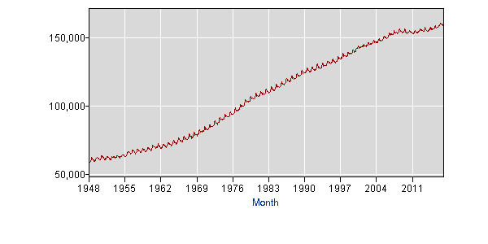
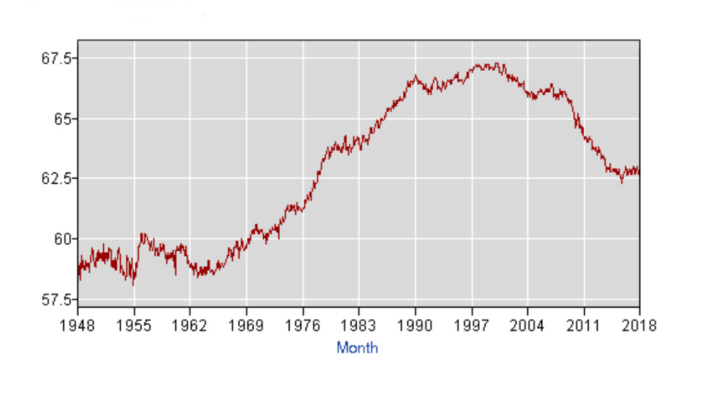
Peak Labor?
U.S. Civilian noninstitutional population (thousands) 16 years and over (not seasonally adjusted)
U.S. Civilian Labor Force Level (thousands) 16 years and over (not seasonally adjusted)
Peak Labor
U.S. Civilian Labor Force Participation Rate 16 years and over (not seasonally adjusted)
The number of job lost due to technology and automation will exceed those that are being created.
Source: US Department of Labor, Bureau of Labor Statistics

Slide 39
Conclusion on AI
Conclusion on Artificial Super Intelligence
Disruptive Artificial Superintelligence
Attack of the Killer Computer

Slide 40
Legal
The Company does not, and cannot guarantee that its SPY-oriented product or other products will actually generate an expected risk/return profile and states that its investment strategies and products may create losses of principal value. Additionally, neither past performance nor management’s confidence are guarantees of future results.
This presentation is for informational purposes only and does not constitute an offer or solicitation to sell shares or securities in the Company or any related or associated company. Any such offer or solicitation will be made only by means of the Company's confidential Offering Memorandum and in accordance with the terms of all applicable securities and other laws. None of the information or analyses presented are intended to form the basis for any investment decision, and no specific recommendations are intended. Accordingly this presentation does not constitute investment advice or counsel or solicitation for investment in any security. This presentation does not constitute or form part of, and should not be construed as, any offer for sale or subscription of, or any invitation to offer to buy or subscribe for, any securities, nor should it or any part of it form the basis of, or be relied on in any connection with, any contract or commitment whatsoever. The Company expressly disclaims any and all responsibility for any direct or consequential loss or damage of any kind whatsoever arising directly or indirectly from: (i) reliance on any information contained in the presentation, (ii) any error, omission or inaccuracy in any such information or (iii) any action resulting therefrom.
Duplication, transmission or storage by any means whatsoever is expressly prohibited.

